Slide 1
PRIMS aLGORITHM
What is a Minimum Spanning Tree (MST)?
A tree that connects all the vertices in a graph
Uses the minimum total edge weight
No cycles
Used in network design (like roads, wiring, etc.)

Slide 2
What is Prim’s Algorithm?
A greedy algorithm to find the MST
Starts from any vertex
Always picks the minimum weight edge that connects a vertex in the MST to a vertex outside the MST

Slide 3
ALGORITHM
Start from any vertex (say A)
Mark it as visited
Pick the smallest edge connecting the visited set to the unvisited set
Add that edge and vertex to the MST
Repeat until all vertices are included

Slide 4
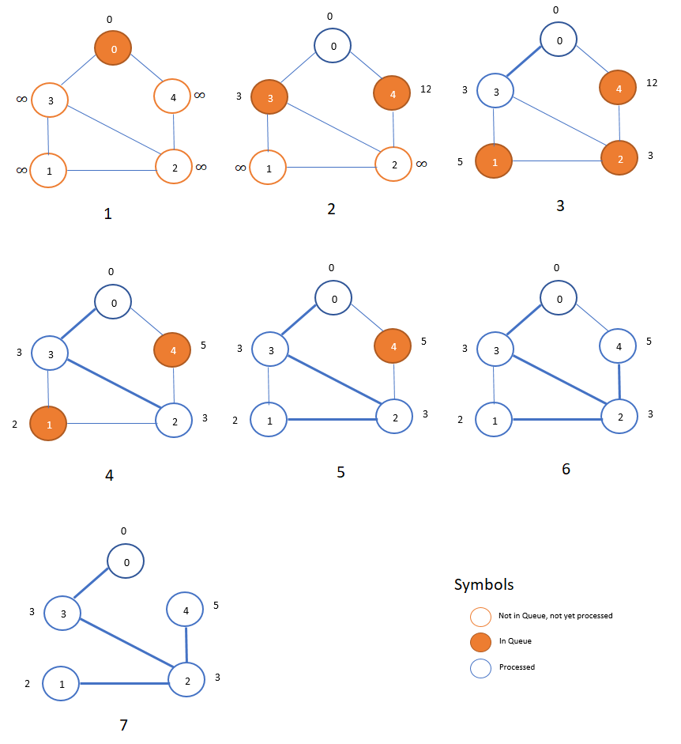
EXAMPLE

Slide 5
Key Points
Greedy strategy
Time complexity: O(V²) with adjacency matrix, O(E log V) with priority queue + adjacency list
Works for connected, weighted, undirected graphs

Slide 6


